Slide 1
DATA SYNTHESIS
PRESENTED BY
VASUNDHARA V
821721104058
B.E CSE
Sir Issac Newton College of Engineering and Technology

Slide 2
AGENDA
PROBLEM STATEMENT
PROJEPRCT OVERVIEW
WHO ARE THE END USERS?
YOUR SOLUTION AND ITS VALUE PROPOSITION
THE WOW IN YOUR SOLUTION
MODELLING
BENEFITS
RESULTS
APPLICATION AREA

Slide 3
PROBLEM STATEMENT
Data synthesis is the process of generating new data points that mimic the statistical properties of an existing dataset. This task is crucial in various domains such as machine learning, where the availability of labeled data is often limited. However, data synthesis presents several challenges, including preserving privacy, maintaining data utility, and ensuring the generated data accurately represents the underlying distribution.
Privacy Preservation: Develop techniques to generate synthetic data while preserving the privacy of individuals represented in the original dataset.
Data Utility: Create synthetic data that retains the utility of the original dataset for downstream tasks such as analysis, modeling, and decision-making.
Evaluation Metrics: Define robust evaluation metrics to assess the quality and effectiveness of synthetic data generation techniques.
Scalability and Efficiency: Design scalable and efficient algorithms for generating synthetic data, particularly for large-scale datasets.
Application-Specific Considerations: Consider the specific requirements and constraints of different applications and domains when developing data synthesis methods.

Slide 4
PROJEPRCT OVERVIEW
This project aims to develop a robust data synthesis framework called SynthGen to address the challenges of privacy preservation, data utility, scalability, and application-specific requirements.
Objectives:
Develop algorithms for generating synthetic data that preserve privacy while maintaining utility.
Define evaluation metrics to assess the quality and effectiveness of synthetic data generation.
Methodology:
Privacy-Preserving Synthesis
Scalable Synthesis
Evaluation Metrics
Expected Outcomes:
SynthGen framework for generating privacy-preserving synthetic data.
Scalable algorithms for efficient synthesis of large-scale datasets.
Comprehensive evaluation metrics for assessing synthesized data quality.

Slide 5
WHO ARE THE END USERS?
Data Scientists and Analysts: Data scientists and analysts often use synthetic data for model training, testing, and validation purposes.
Researchers: Researchers across various fields, including healthcare, social sciences, and economics, use synthetic data to conduct studies and experiments.
Data Privacy Professionals: Data privacy professionals, including privacy officers and compliance managers, utilize data synthesis techniques to anonymize and de-identify datasets while preserving their utility for analysis and research.
Data Sharing Platforms: Platforms and organizations that facilitate data sharing and collaboration, such as research consortia, government agencies, and data marketplaces, may employ data synthesis techniques to generate synthetic versions of datasets for wider distribution.
Software Developers: Developers of applications and tools that rely on data, such as recommendation systems, fraud detection algorithms, and personalization engines, may integrate synthetic data generation capabilities into their products.
Data Owners and Custodians: Organizations that own or manage sensitive datasets, including healthcare providers, financial institutions, and research institutions, may leverage data synthesis techniques to generate synthetic versions of their data for internal use or external sharing.

Slide 6
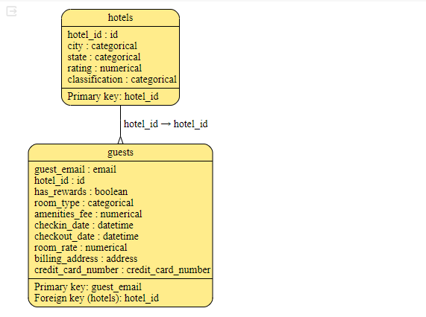
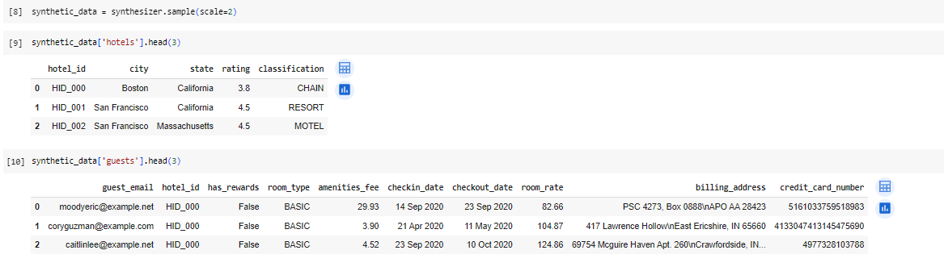
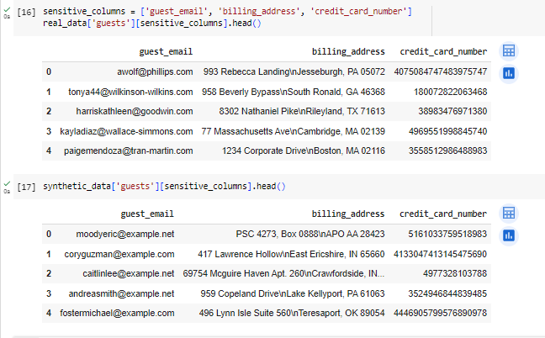
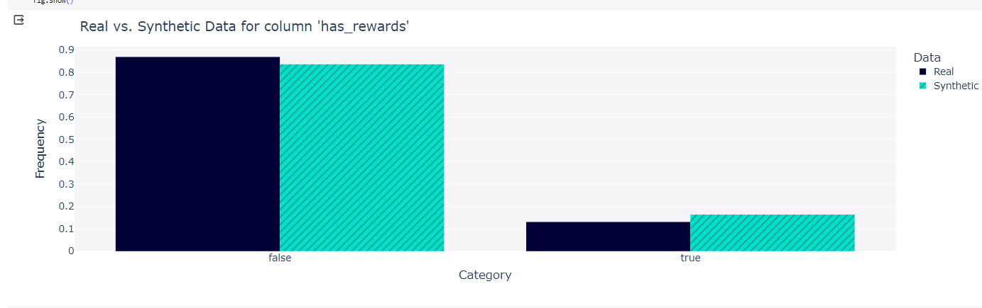
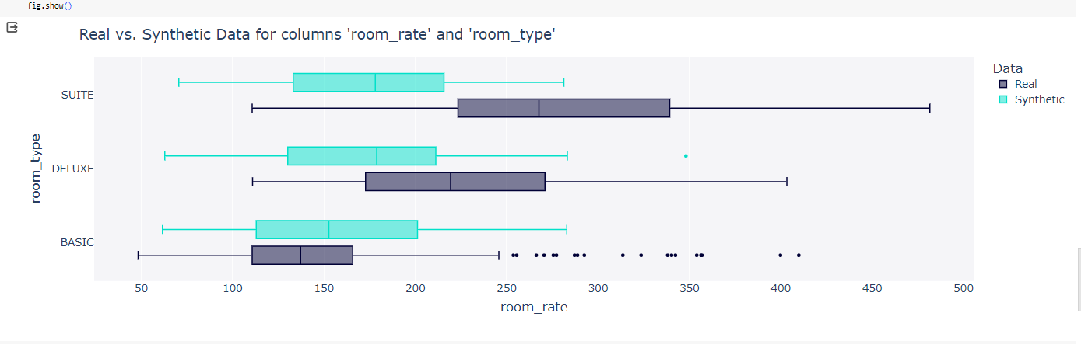
YOUR SOLUTION AND ITS VALUE PROPOSITION

Slide 7
THE WOW IN YOUR SOLUTION
To generate synthetic data while safeguarding individual privacy. This ensures that sensitive information remains protected, making SynthGen a pioneer in privacy-aware data synthesis.
SynthGen introduces comprehensive evaluation metrics that go beyond basic measures of data utility. Our metrics assess not only privacy preservation and fidelity to the original data distribution but also the suitability of synthetic data for specific downstream tasks.
SynthGen features an intuitive, user-friendly interface that streamlines the data synthesis process. With easy-to-use controls and customizable parameters, users can effortlessly generate synthetic data tailored to their specific needs, empowering them to unlock the full potential of their datasets without specialized expertise.
SynthGen sets a new standard for privacy-preserving synthetic data generation, revolutionizing how organizations leverage data for insights and innovation.

Slide 8
MODELLING
Probabilistic Models
Generative Adversarial Networks (GANs)
Markov Chain Monte Carlo (MCMC) Methods
Kernel Density Estimation (KDE)
BENEFITS
Privacy Preservation
Data Augmentation
Risk-Free Experimentation
Cost and Time Savings
Addressing Data Scarcity

Slide 9
RESULTS
Generated Synthetic Data: The primary result of data synthesis is the creation of synthetic data that closely resembles the statistical properties of the original dataset.
Privacy-Preserving Data: Data synthesis techniques can produce synthetic data that preserves privacy by removing or obfuscating personally identifiable information (PII) while retaining the utility of the data for analysis and modeling purposes.
Improved Data Quality: Data synthesis can improve the quality of the dataset by filling in missing values, correcting errors, and reducing noise.
Enhanced Model Performance: Synthetic data can be used to augment training datasets, leading to improved performance of machine learning models.
Validation and Testing: Synthetic data can be used for validation and testing purposes, allowing researchers and practitioners to assess the robustness and reliability of algorithms and systems under different conditions

Slide 10
APPLICATION AREAS
Medical Imaging: Synthetic data can be generated to augment limited datasets for training deep learning models used in medical image analysis, such as MRI, CT, and X-ray scans.
Clinical Trials: Synthetic patient data can simulate diverse patient populations, helping researchers design and validate clinical trial protocols and treatments.
Healthcare Analytics: Synthetic healthcare records enable analysis of patient outcomes, disease trends, and treatment effectiveness while maintaining patient privacy.
Market Research: Synthetic consumer data enables market analysis, trend identification, and competitor benchmarking while protecting individual privacy.
Environmental Science: Synthetic environmental data aids in climate modeling, ecological studies, and environmental impact assessments, supporting conservation efforts and policy-making.

